Slide 1





Globally Harmonized System
GHS
Notes:
Provide attendees with the following before you begin your training presentation:
OSHA Quick Card – Hazard Communication – Pictograms (OSHA 3491). Available in both English and Spanish.
OSHA Quick Card – Hazard Communication – Standard Labels (OSHA 3492). Available in both English and Spanish.
OSHA Quick Card – Hazard Communication – Safety Data Sheets (OSHA 3493). Available in both English and Spanish.

Slide 2

What is GHS?
The GHS is a system for standardizing and harmonizing the classification and labeling of chemicals.
It is a logical and comprehensive approach to:
  Defining hazards of chemicals;
  Creating classification processes
  Communicating hazard information and protective measures
The “Purple Book”
Notes:
GHS = Globally Harmonized System of Classification and Labeling of Chemicals.
GHS is not a regulation or a standard. A Guide to the Globally Harmonized System of Classification and Labeling of Chemicals (GHS), referred to as the “Purple Book”, establishes agreed hazard classification and communication provisions and includes information on how to apply the system.
The Guide is 568 pages long.

Slide 3
What is GHS?
GHS
System for standardizing and harmonizing
Logical and comprehensive approach
Defining Hazards
Creating Classification Processes
Communicating Information
Notes:
This is another way to explain it.

Slide 4
What is the Purpose of GHS?
Standardized system
Enhances global trade
Enhances protections
Reduces confusion
OSHA has adopted GHS under its Hazard Communication Standard (HCS).
Notes:
The purpose of the HazCom GHS changes is “To ensure that the hazards of all chemicals produced or imported are classified, and that information concerning the classified hazards is transmitted to employers and employees.”
HCS = Hazard Communication Standard.

Slide 5
Three Key Areas
Hazard classification
Labels
Safety Data Sheets
Notes:
The three key areas are Hazard Classification, Labels, and Safety Data Sheets.
Given recent changes to OSHA’s Hazard Communication Standard and the movement to a globally harmonized hazard communication system, the employees attending this training should be able to understand key elements of the new system.

Slide 6









GHS PICTOGRAMS
Notes:
GHS Pictograms

Slide 7

Flame Over Circle
Oxidizers
Increased fire & explosion risk
Notes:
Flame Over Circle = Oxidizers

Slide 8

Gas Cylinder
Gases Under Pressure can explode, rocket and damage health if they are heated, ruptured or leaking
Notes:
Gas Cylinder = Gases Under Pressure

Slide 9

Exploding Bomb
Explosives
Self Reactives
Organic Peroxides
Notes:
Exploding Bomb = Explosives / Self Reactives / Organic Peroxides

Slide 10

Corrosion
Skin corrosion or burns
Eye Damage
Corrosive to metals
Notes:
Corrosion = Corrosives

Slide 11

Flame
Flammables
Self Reactives
Pyrophorics
Self-Heating
Emits Flammable Gas
Organic Peroxides
Notes:
Flame = Flammables / Self Reactives / Pyrophorics / Self-Heating / Emits Flammable Gas / Organic Peroxides

Slide 12

Health Hazard
Carcinogen
Respiratory Sensitizer
Reproductive Toxicity
Target Organ Toxicity
Mutagenicity
Aspiration Toxicity
Notes:
Health Hazard = Carcinogen / Respiratory Sensitizer / Reproductive Toxicity / Target Organ Toxicity / Mutagenicity / Aspiration Toxicity

Slide 13

Skull & Crossbones
Acute Toxicity (severe or fatal)
Usually used in combination with Health Hazard pictogram
Notes:
Skulls & Crossbones = Acute Toxicity (severe)

Slide 14

Exclamation Mark
Irritant
Skin Sensitizer
Acute Toxicity
Narcotic Effects
Respiratory Tract
Irritation
Notes:
Exclamation Mark = Irritant / Skin Sensitizer / Acute Toxicity (harmful) / Narcotic Effects / Respiratory Tract / Irritation

Slide 15

Environment
Aquatic Toxicity
(Non-mandatory category)
Notes:
Environment = Aquatic Toxicity

Slide 16
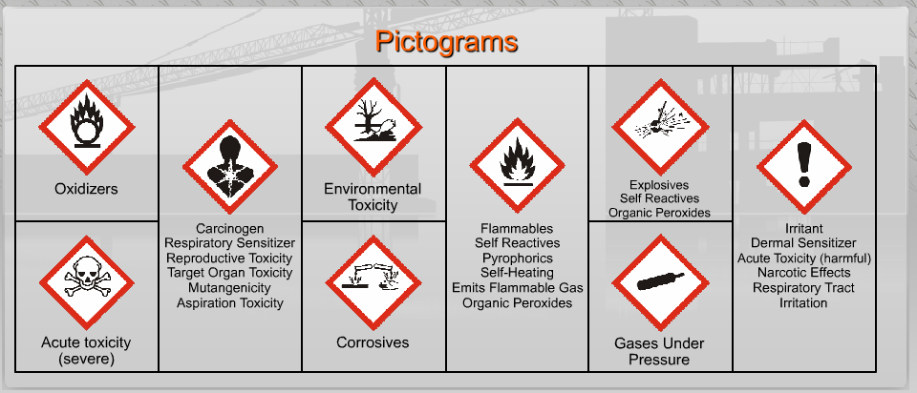
Pictograms
Notes:
There are 9 Pictograms.
Give the attendees a few minutes to study the chart further as they will be asked to identify each one in the next slides.

Slide 17
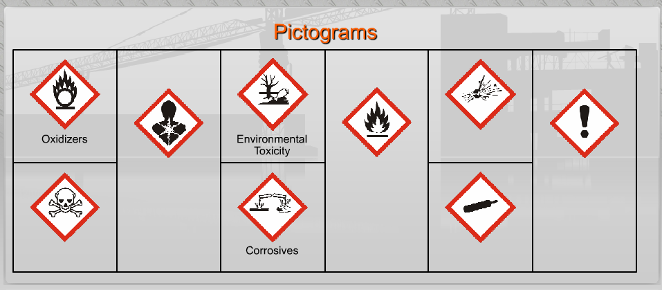
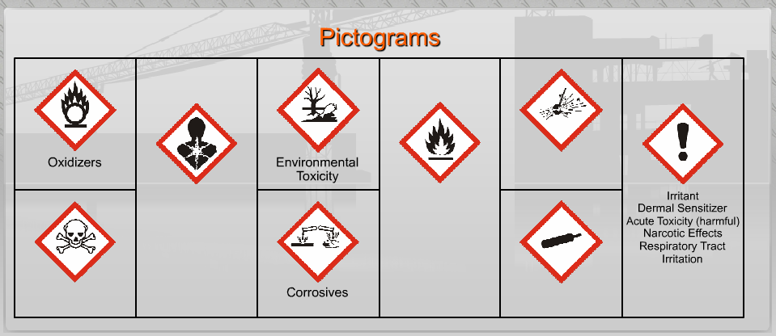
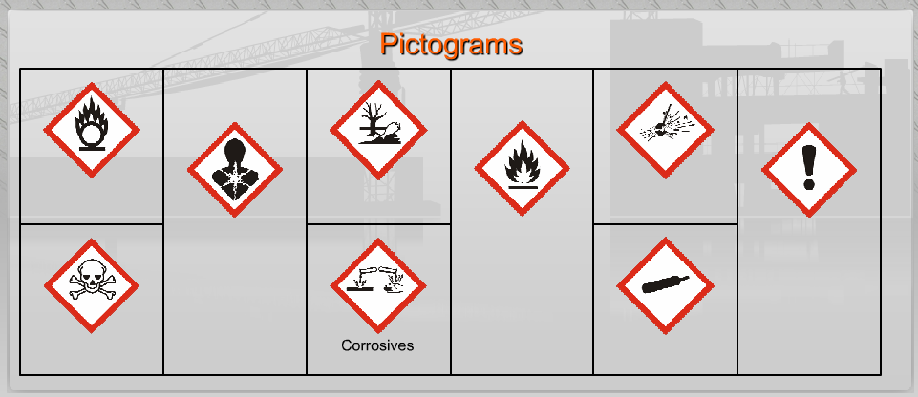
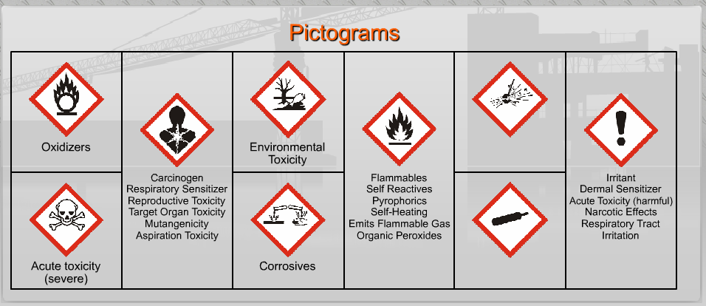
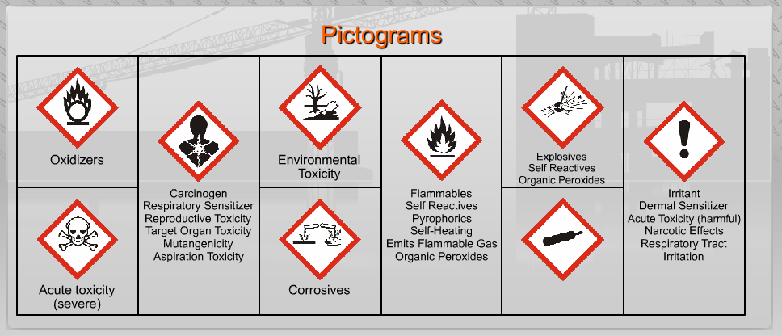
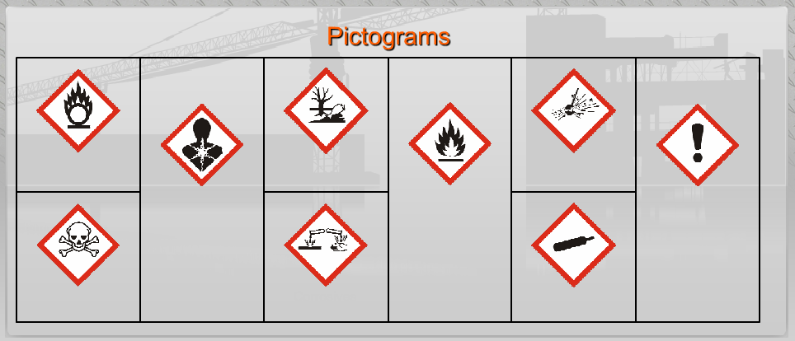
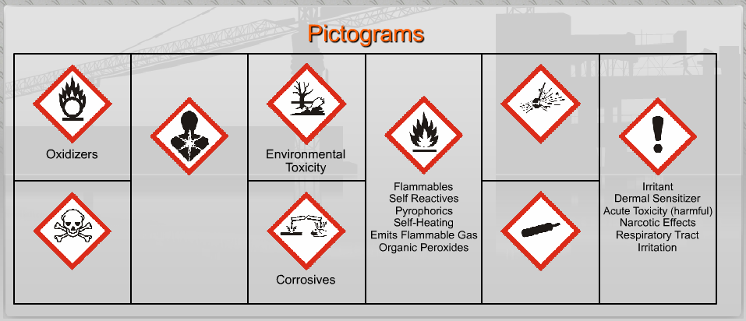
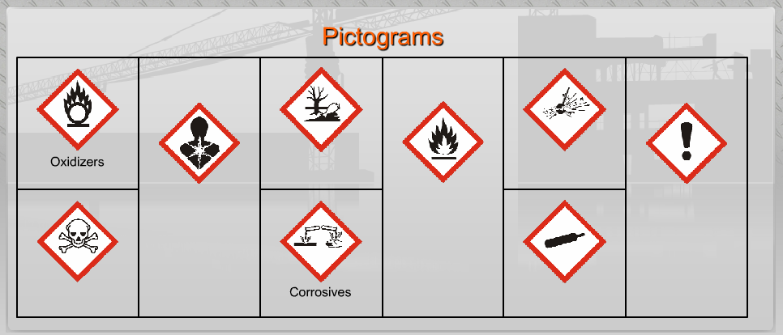
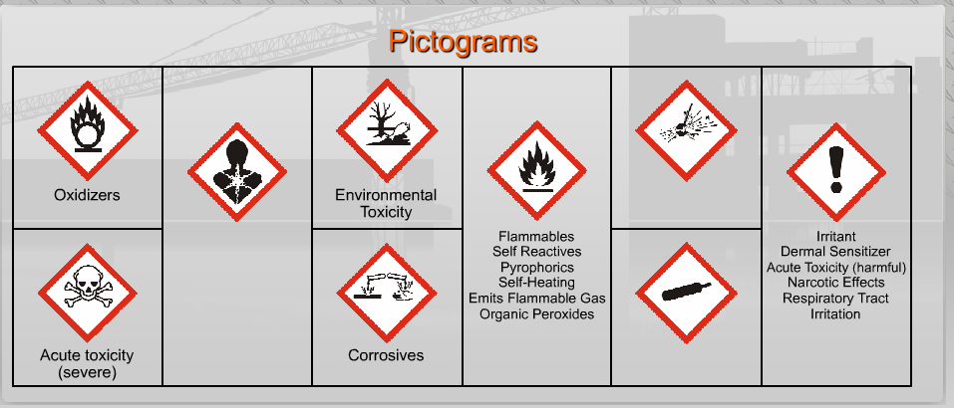
Pictograms
Notes:
Ask the attendees to identify the Pictograms in the following order:
Which Pictogram is for Corrosives?
Which Pictogram is for Oxidizers?
Which Pictogram is for Environmental Toxicity?
Which Pictogram is for Irritants?
Which Pictogram is for Flammables?
Which Pictogram is for Acute toxicity?
Which Pictogram is for Carcinogens?
Which Pictogram is for Explosives?
And, finally, which Pictogram is for Gases Under Pressure?

Slide 18
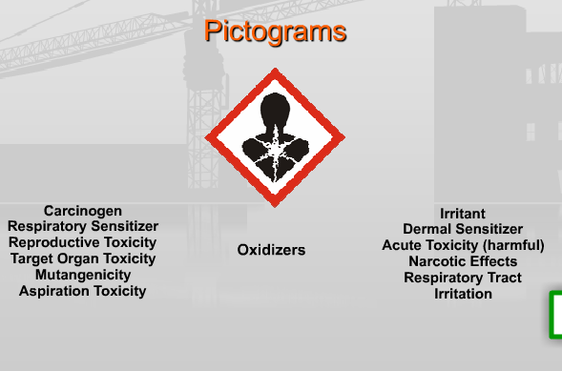
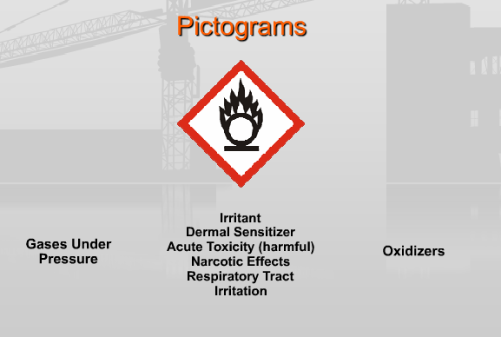
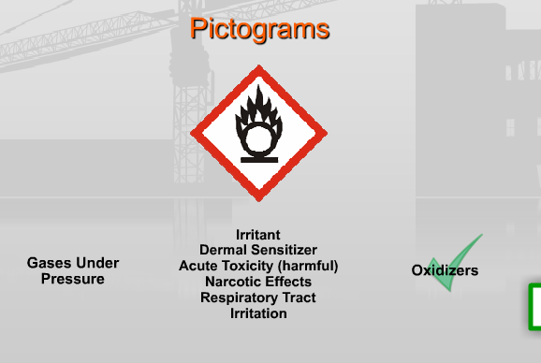
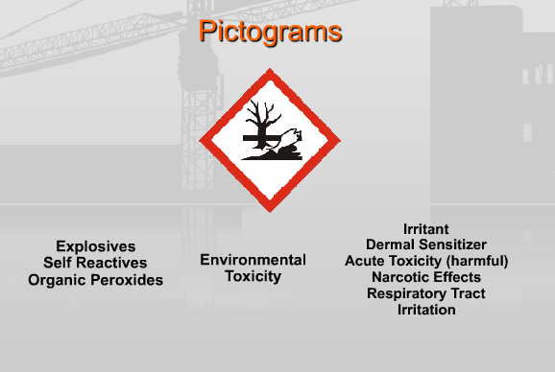
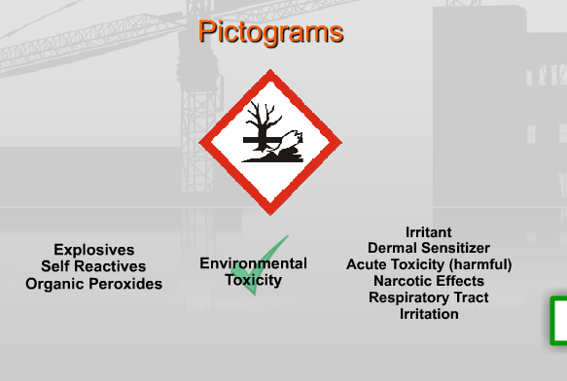
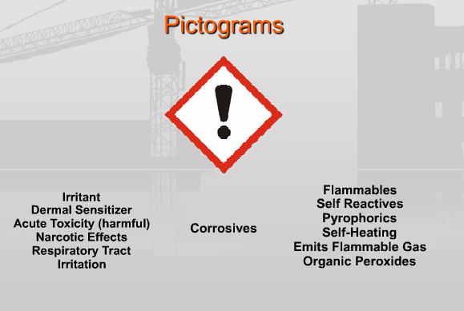
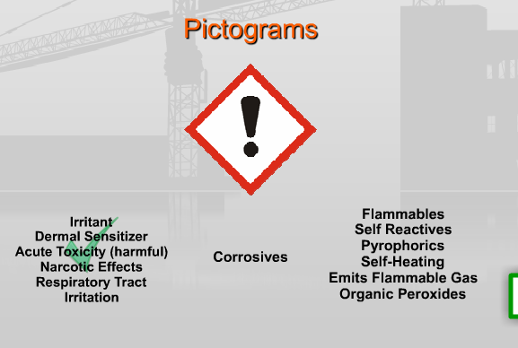
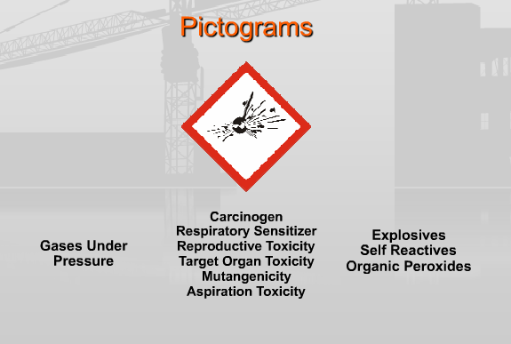
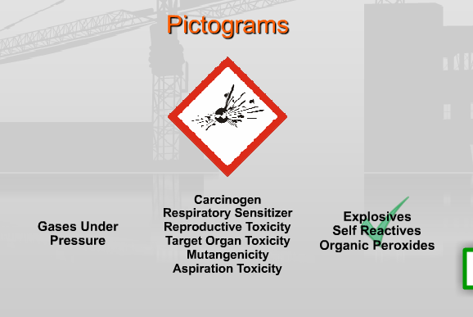
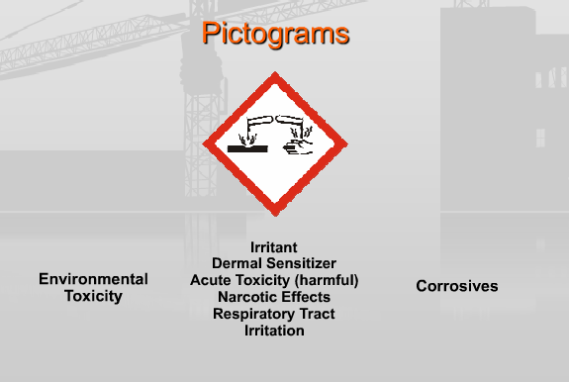
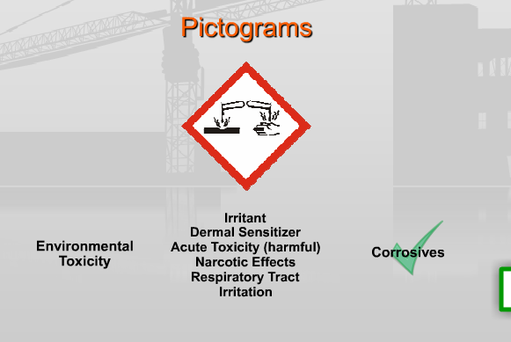
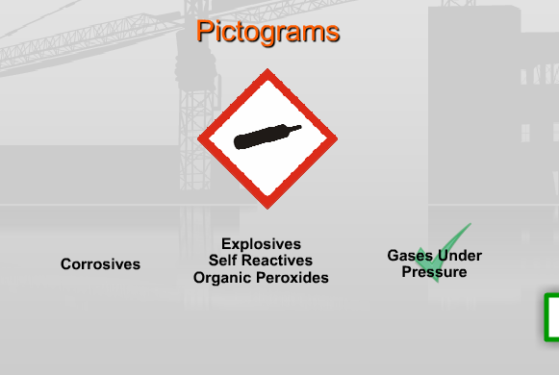
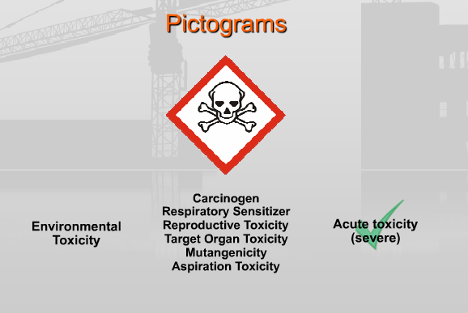
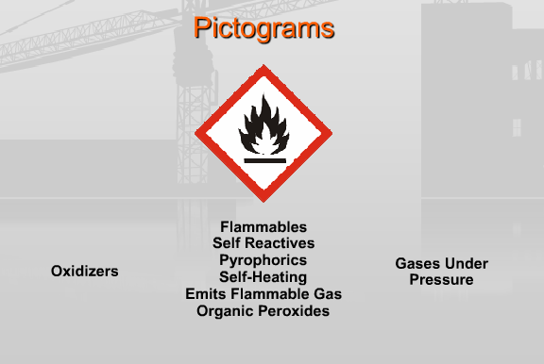
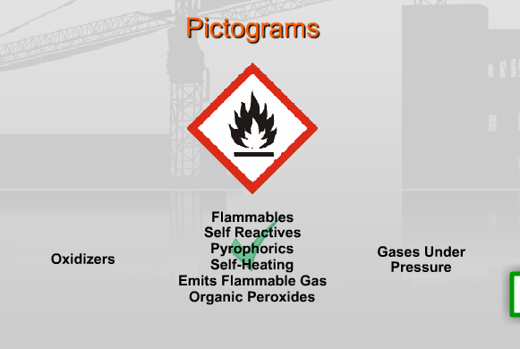
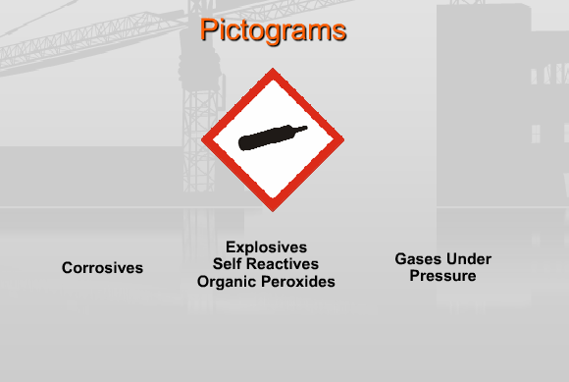
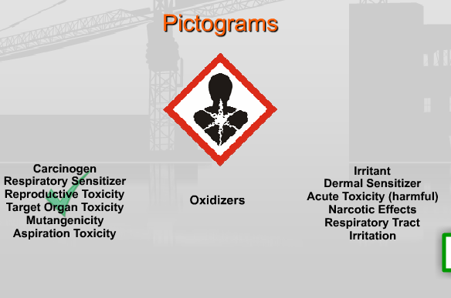
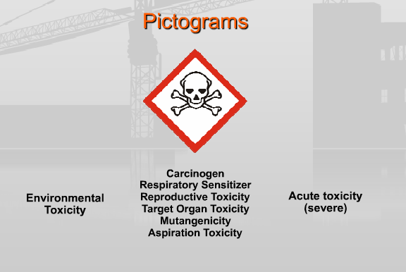
Pictograms
Notes:
Now, we will try something a little different. Match the Pictograms with the correct written description:
Oxidizers
Environmental Toxicity
Irritant
Explosives
Flammables
Corrosives
Carcinogen
Gasses under pressure
Acute toxicity

Slide 19
GHS LABELING
Notes:
GHS Labeling

Slide 20
Label Elements
Labels must contain all of these required elements:
  Product Identifier
  Pictograms
  Signal Words
  Hazard Statements
  Precautionary Statements
  Contact Information
Notes:
New Label Elements

Slide 21


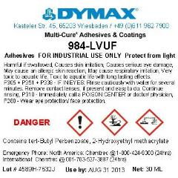
Label Elements
While there is no specific format required for the new labels, they MUST HAVE ALL 6 ELEMENTS ON IT SOMEWHERE that are easily identifiable, understandable and match shipping labels.
Notes:
New Label Elements

Slide 22
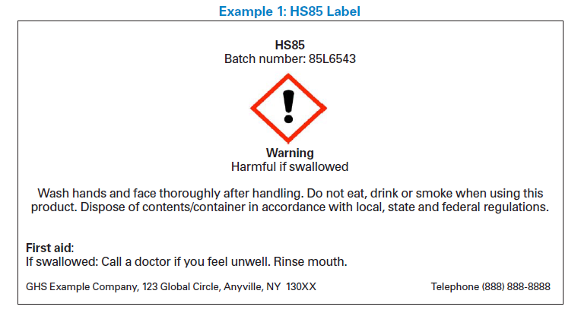
Label Elements
Product Identifier
The Product Identifier is how the hazardous chemical is identified. This can be (but is not limited to):
  Chemical Name
  Code Number
  Batch Number
Notes:
Product Identifier

Slide 23
Label Elements
Pictograms
Pictograms are graphic symbols used to communicate specific information about the hazards of a chemical.
There are a total of 9 GHS Pictograms used to illustrate hazard classification.
Notes:
These are the same Pictograms we just reviewed.

Slide 24
Label Elements
Signal Words
Signal Words are used to indicate the relative level of severity of the hazard and alert the reader to a potential hazard on the label. Only two words are used:
  Danger – more severe hazards.
  Warning – less severe hazards.
Notes:
Signal Words = Danger or Warning.

Slide 25
Label Elements
Hazard Statements
Hazard Statements describe the nature of the hazard(s) of a chemical.
  It may include the degree of hazard.
Notes:
Hazard Statements

Slide 26
Label Elements
Precautionary Statements
Precautionary Statements describe recommended measures that should be taken to minimize or prevent adverse effects resulting from exposure to the hazardous chemical or improper storage or handling.
There are four types of precautionary statements:
  Prevention − Response
  Storage − Disposal
Notes:
Precautionary Statements = Prevention / Storage / Response / Disposal

Slide 27
Label Elements
Contact Information
This information will be for the ‘responsible party’ of the substance. This may be the chemical manufacturer, importer or other responsible party. You will generally see this information at the bottom of the label.
  Name
  Address
  Telephone Number
Notes:
Contact Information

Slide 28

Workplace Labels
  Employers are responsible for maintaining the labels on containers.
Employers are NOT responsible for updating labels on shipped containers.
Notes:
Workplace Labels

Slide 29

Workplace Labels
Employers have the option to create their own workplace labels.
  Employers may continue to use rating systems such as NFPA 704 Diamonds
  No conflicting hazard warnings or
  pictograms can be used.
Notes:
Workplace Labels

Slide 30
Safety Data Sheets
Notes:
Safety Data Sheets

Slide 31
Safety Data Sheets
The SDS replaced the MSDS (Material Safety Data Sheet).
Provides comprehensive information about a chemical substance or mixture.
Used by employers and employees
Provides more detailed information for what is referenced in the label.
Notes:
SDS = Safety Data Sheets

Slide 32

Safety Data Sheets
Standardized 16-section format.
Label reflects information in SDS
Notes:
SDS

Slide 33
SDS Sections
Format of 16-section SDS should include the following sections:
Section 1. Identification | Section 9. Physical and chemical properties
Section 2. Hazard(s) identification | Section 10. Stability and reactivity
Section 3. Composition./information on ingredients | Section 11. Toxicological information
Section 4. First aid measures | Section 12. Ecological information
Section 5. Fire-fighting measures | Section 13. Disposal considerations
Section 6. Accidental release measures | Section 14. Transport information
Section 7. Handing and storage | Section 15. Regulatory information
Section 8. Exposure controls/personal protection | Section 16. Other information, including date of preparation or last revision
Notes:
The new SDS format contains 16 headings.

Slide 34
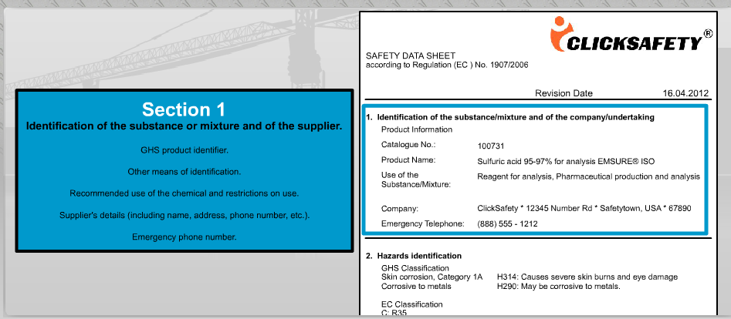
SDS Sections
Section 1: Identification includes product identifier; manufacturer or distributor name, address, phone number; emergency phone number; recommended use; restrictions on use.
Manu Company
Notes:
Section 1: Identification includes product identifier; manufacturer or distributor name, address, phone number; emergency phone number; recommended use; restrictions on use.

Slide 35
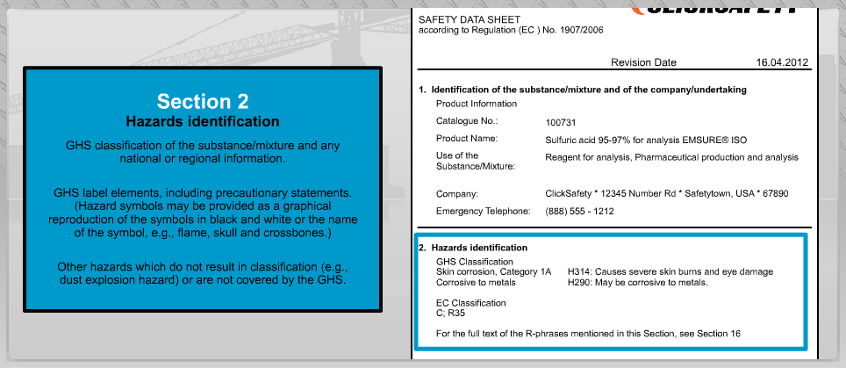
SDS Sections
Section 2: Hazard(s) identification includes all hazards regarding the chemical; required label elements.
Notes:
Section 2: Hazard(s) identification includes all hazards regarding the chemical; required label elements.

Slide 36
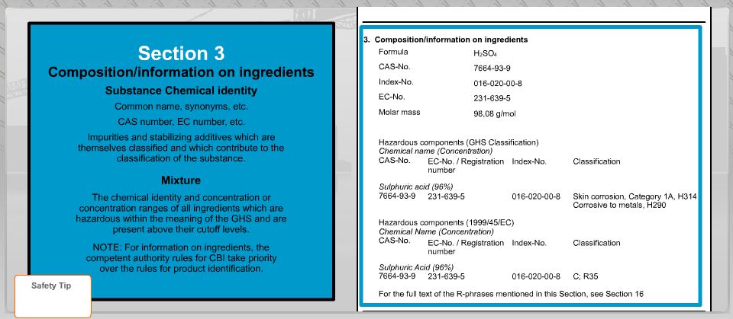
SDS Sections
Section 3: Composition/information on ingredients includes information on chemical ingredients; trade secret claims.
Notes:
Section 3: Composition/information on ingredients includes information on chemical ingredients; trade secret claims.

Slide 37
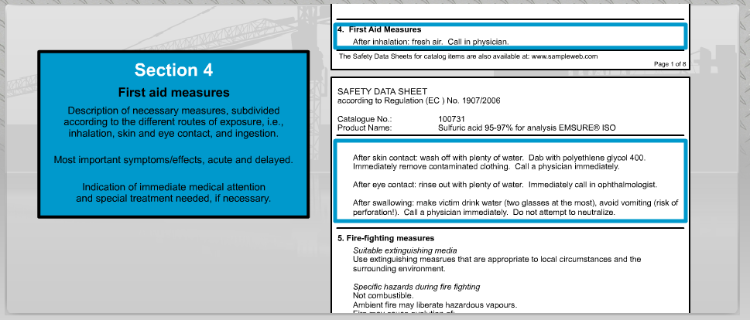
SDS Sections
Section 4: First aid measures includes important symptoms/ effects, acute, delayed; required treatment.
Notes:
Section 4: First aid measures includes important symptoms/ effects, acute, delayed; required treatment.

Slide 38
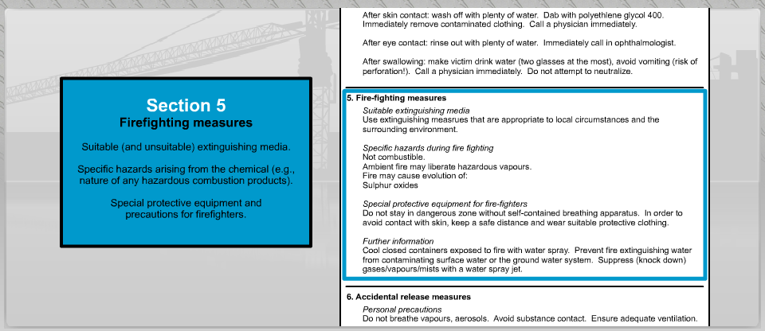
SDS Sections
Section 5: Firefighting measures lists suitable extinguishing techniques, equipment; chemical hazards from fire.
Notes:
Section 5: Firefighting measures lists suitable extinguishing techniques, equipment; chemical hazards from fire.

Slide 39
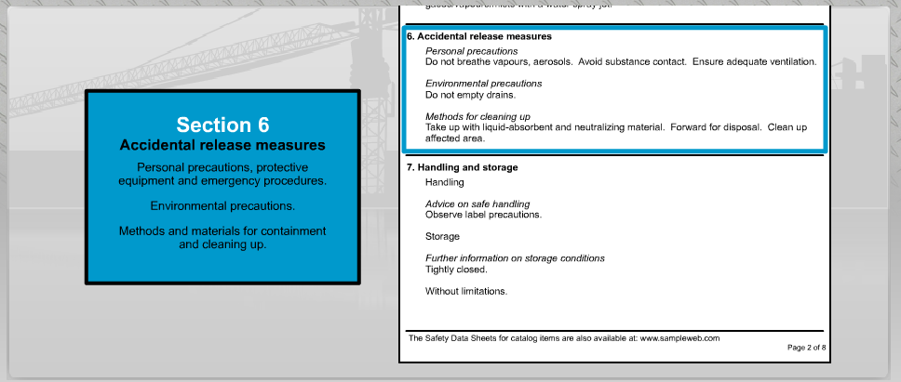
SDS Sections
Section 6: Accidental release measures lists emergency procedures; protective equipment; proper methods of containment and cleanup.
Notes:
Section 6: Accidental release measures lists emergency procedures; protective equipment; proper methods of containment and cleanup.

Slide 40
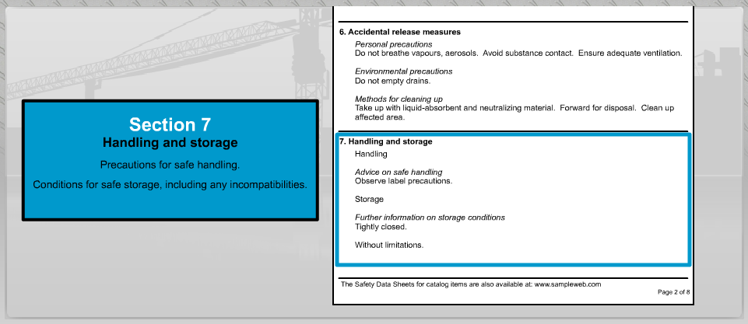
SDS Sections
Section 7: Handling and storage lists precautions for safe handling and storage, including incompatibilities.
Notes:
Section 7: Handling and storage lists precautions for safe handling and storage, including incompatibilities.

Slide 41
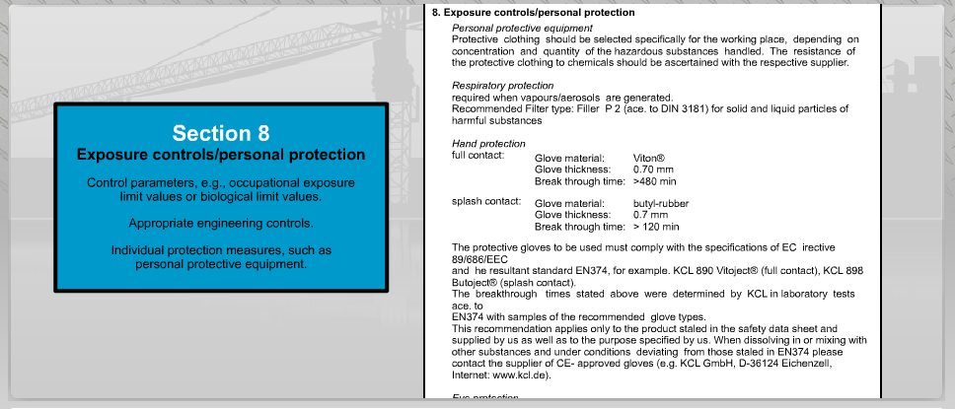
SDS Sections
Section 8: Exposure controls/personal protection lists OSHA's Permissible Exposure Limits (PELs); Threshold Limit Values (TLVs); appropriate engineering controls; personal protective equipment (PPE).
Notes:
Section 8: Exposure controls/personal protection lists OSHA's Permissible Exposure Limits (PELs); Threshold Limit Values (TLVs); appropriate engineering controls; personal protective equipment (PPE).

Slide 42
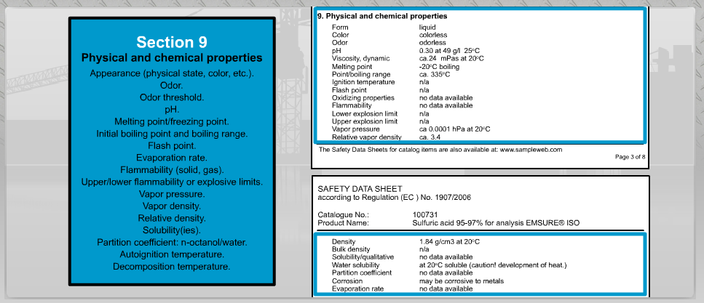
SDS Sections
Section 9: Physical and chemical properties lists the chemical's characteristics.
Notes:
Section 9: Physical and chemical properties lists the chemical's characteristics.

Slide 43
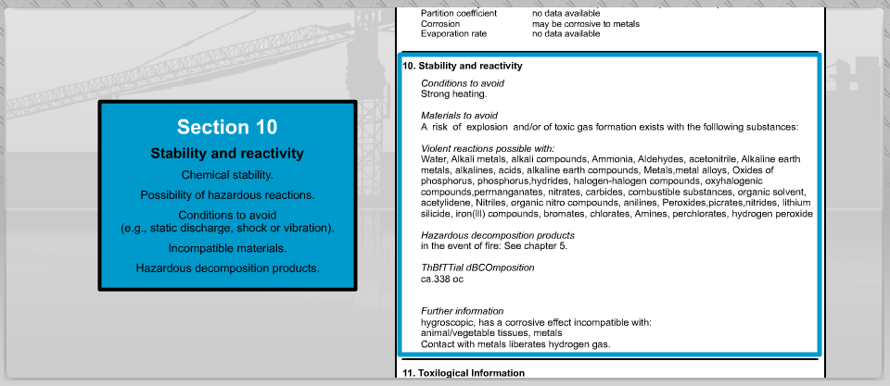
SDS Sections
Section 10: Stability and reactivity lists chemical stability and possibility of hazardous reactions.
Notes:
Section 10: Stability and reactivity lists chemical stability and possibility of hazardous reactions.

Slide 44
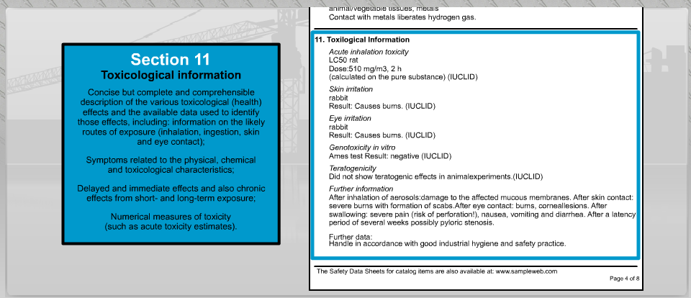
SDS Sections
Section 11: Toxicological information includes routes of exposure; related symptoms, acute and chronic effects; numerical measures of toxicity.
Notes:
Section 11: Toxicological information includes routes of exposure; related symptoms, acute and chronic effects; numerical measures of toxicity.

Slide 45
SDS Sections
Note: Since other Agencies regulate this information, OSHA does not enforce Sections 12 through 15 (29 CFR 1910.1200(g)(2)).
  Section 12, Ecological information
  Section 13, Disposal considerations
  Section 14, Transport information
  Section 15, Regulatory information
Notes:
Sections 12-15 will not be enforced by OSHA.

Slide 46
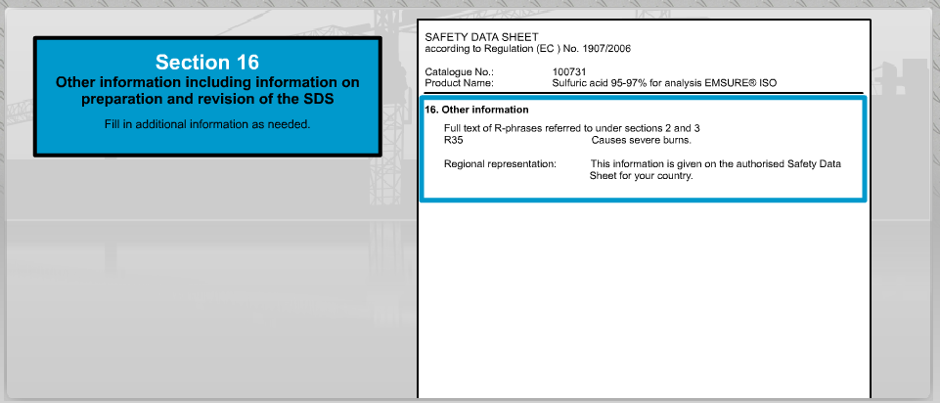
SDS Sections
Section 16: Other information includes the date of preparation or last revision.
Notes:
Section 16: Other information includes the date of preparation or last revision.

Slide 47
Safety Data Sheets
So, what do you do if you find a chemical in your workplace, and after reading the label, you still aren’t sure how you should handle it?
  Consult the safety data sheet, or SDS for the chemical.
There should be an SDS readily available for every chemical you might encounter, and if there isn’t, then request one immediately.
This is a key component of the HazCom Standard and is not changed by GHS.
GHS specifies the format for the SDS.
Notes:
Employers must ensure that the SDSs are readily accessible to employees for all hazardous chemicals in their workplace. This may be done in many ways. For example, employers may keep the SDSs in a binder or on computers as long as the employees have immediate access to the information without leaving their work area when needed and a back-up is available for rapid access to the SDS in the case of a power outage or other emergency. Furthermore, employers may want to designate a person(s) responsible for obtaining and maintaining the SDSs. If the employer does not have an SDS, the employer or designated person(s) should contact the manufacturer to obtain one.

Slide 48
KCI Policy
Found in Section 11 of the Kitchell Safety Manual
Training provided for all potentially exposed employees
  Initially
  Whenever expected to handle a new chemical
Safety Data Sheets
Notes:
Section 16: Other information includes the date of preparation or last revision.

Slide 49
Scenario
You’ve been working at KCI for several years. One day you notice that a new chemical has been provided to help break down concrete in a slick line. You notice it has a pretty strong smell. What should you do?
Carefully read the label to determine its identity and any possible hazards.
Ask your supervisor what he might know about the chemical.
Consult the SDS on the chemical to get more information.
Notes:
Answer: a.
Excellent choice! Do make sure that you involve your supervisor too. He may already have some information that could be helpful.

Slide 50
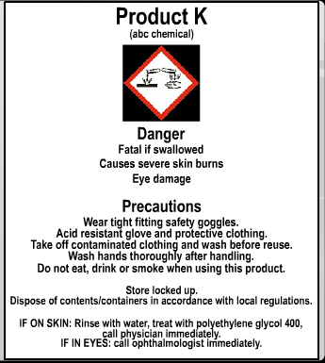
Scenario
OK, you’ve read the label and discussed with your supervisor, but still have some concerns about how to properly use it.
Here’s what the label said:
Notes:
Scenario

Slide 51
Scenario
What do you do now?
Warn everyone in the vicinity not to use the chemical and immediately consult the SDS for more information.
Follow the label precautions, but go ahead and use the chemical.
Ask Jeb, a co-worker, to fill in for you. He has always had a knack for getting by in dangerous situations.
Notes:
Answer: a.
Good decision. Go get the SDS and carefully review it to be completely prepared before starting work with the chemical.

Slide 52
Scenario
Well, even after studying the SDS, you are not clear about how to handle all aspects of the product. What’s your best option now?
Forget it, you’re too detailed, it’s time to get to work.
Stop work, contact your supervisor or safety rep who may end up calling the manufacturer or supplier.
Proceed with the job and figure it out as you go. You’ve got to start sooner or later.
Notes:
Answer: b.
You betcha! Go for it.

Slide 53
Resources
Information is available from OSHA’s website at www.osha.gov/dsg/hazcom/index.html
Pictogram Quick Card
Label Quick Card
Safety Data Sheet Quick Card
Safety Data Sheet OSHA Brief
Label/Pictogram OSHA Brief
NFPA 704/HazCom 2012 Comparison
Notes:
Resources

Slide 54
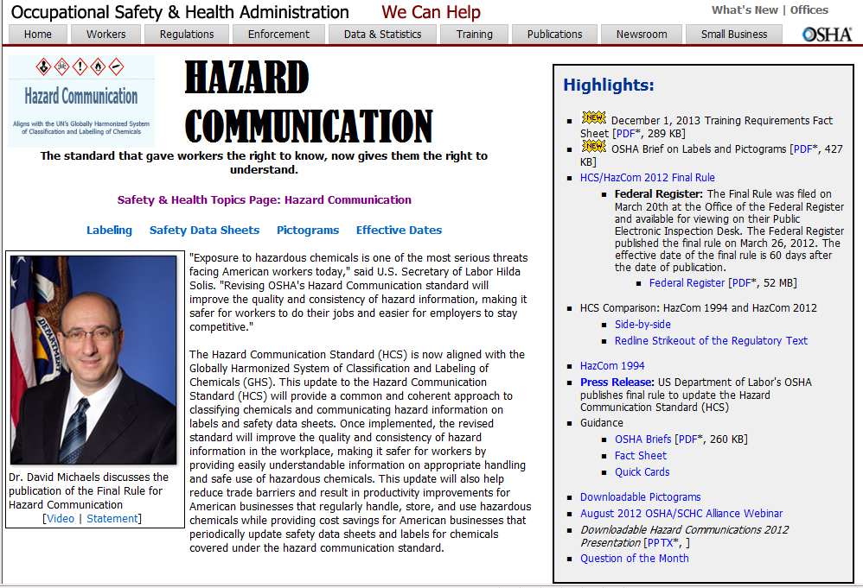
Resources
OSHA HazCom Web Page
Notes:
OSHA HazCom Web Page

Slide 55
Resources
OSHA Guidance and Outreach
Notes:
OSHA Quick Card – Hazard Communication – Standard Pictogram (OSHA 3491)
OSHA Quick Card – Hazard Communication – Standard Labels (OSHA 3492)
OSHA Quick Card – Hazard Communication – Safety Data Sheets (OSHA 3493)

Slide 56
Globally Harmonized System
GHS
Notes:
Questions? You will now take a short quiz to confirm your comprehension of this training.

