Slide 1
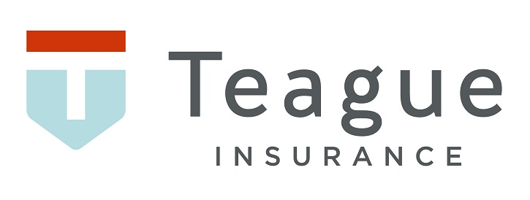
Teague Insurance Agency
Injury & Illness Prevention Plan (IIPP)
-T8 CCR 3203
Notes:
Welcome to Teague Insurance Agency’s tutorial on completing and implementing an effective injury and illness prevention plan. Give introduction: Name
What is an IIPP?
CA’s equivalent to Federal and other state OSHA plan’s Safety and Health Management program. The requirement for this program was first put into effect on July 1, 1991, and is the “Master” program for all other required programs. Meaning that all other safety programs are subject to the IIPP.
Essentially, it lays out the employer’s responsibility to provide a workplace where hazards to employees have been minimized or eliminated in order to meet their responsibilities for a safe work environment. (General duty clause) Supervisors and managers should note that an IIPP does not need to be an all-in-one program that contains things such as Accident/Incident Investigations, Heat Illness, and so on. These required programs can be separate from the IIPP.
What are the benefits of such a program?
Although injuries and accidents have been common in the workplace since people began to produce and build, there have been noticeable decreases in such incidents in work environments that have implemented an effective IIPP. In addition to decreases of injuries and illnesses, statistically there is reduced cost of doing business in the form of lower insurance premiums, time and money put into the training of employees, and other required financial burdens. Many businesses see an increase in productivity from employees who work with their employers to assure the safety of not only themselves, but their fellow coworkers. And finally, many employees in a variety of companies experience an increase in morale.

Slide 2
Agenda
A review of the IIPP requirements and implementation strategies
Understanding the importance of IIPPs in workplace safety.
Identifying common workplace hazards and risk assessment strategies.
Developing effective training programs for employees.
Maintaining accurate records and documentation.
Ensuring compliance with OSHA and other regulatory standards.
Notes:
Every CA employer must establish, implement and maintain a written IIPP and a copy must be maintained at each worksite or at a central worksite if the employer has non-fixed worksites such as Physical Plant Operations. The requirements for establishing, implementing and maintaining an effective written IIPP are contained in Title 8 of the California Code of Regulations, Section 3203.
Each employee must be aware of the IIPP. This can be accomplished through training, email correspondence, bulletins and other means of communication. All IIPP must have a statement on employee access to the IIPP and other programs
This lesson will cover the basics of what an Injury and Illness Prevention Program is, the benefits of the program, components normally found in an IIPP, inspections and trainings that need to take place once an IIPP has been established, and information on an employee’s rights to access the IIPP.

Slide 3
Safety Analogy
1
Serious Injury
29
Minor Injuries
300
Non-Injury Accidents
3000
Hazards
For every
There Are
Notes:
One study found that for every single fatality there are at least 300,000 at-risk behaviors, defined as activities that are not consistent with safety programs, training and components on machinery. These behaviors may include bypassing safety components on machinery or eliminating a safety step in the production process that slows down the operator. With effective machine safeguarding and training, at-risk behaviors and near misses can be diminished. This also reduces the chance of the fatality occurring, since there is a lower frequency of at-risk behaviors.

Slide 4
8 Program Elements
Responsibility
Compliance
Communication
Hazard Assessment
Accident & Exposure Investigation
Hazard Correction
Training
Record Keeping
Notes:
Create a table of contents in this order and place it in the front of the plan after a cover page. (OSHA inspection example)
CA-OSHA will ask for these two things upon an investigation
Training & Instruction
Record Keeping
The code section requires that the written program consist of the above listed 8 elements.

Slide 5
Responsibility
This section designates an employee with the authority and responsibility for implementing the program
May be referred to as the Responsible Person, Program Administrator, etc.
Position allows designee to delegate to other persons within the business to help with the implementation of the program
Notes:
Best practices are to designate the responsible person by job title instead of name. This gives flexibility within the program during times of turn over.

Slide 6
Employee Compliance
This section is used by an employer to identify the system is will use to ensure employee compliance with all company safe and health work practices
Includes, but not limited to:
Training and retraining programs
Disciplinary actions
Other such means of compliance
Notes:
Promote employee buy-in of the program by including them in development. This could be a company wide meeting, or a group of employees assigned to a safety committee. Incorporate employee feedback into plan.
**It should be noted that disciplinary policies should be laid out in greater detail in employee handbooks rather than the IIPP document as disciplinary actions fall under the umbrella of labor law

Slide 7
Communication
A system for communicating occupational safety and health procedures and concerns to employees
Must be understandable for everyone
Examples:
Conducting meetings
Implementing training programs
Posting written communications
Notes:
Meetings could be provided as a daily huddle, weekly safety meeting, or toolbox talk
Written communications are found in the form of posters and notices
Employers should also provide employees a means to anonymously notify management about workplace hazards. Such a system should encourage employees to report hazards without fear of reprisal.

Slide 8
Hazard Assessment
This sections is where an employer will identify the procedures to be used in identifying and evaluating workplace hazards
Periodic workplace inspections
Safety Data Sheets
Employee report of safety hazard
Notes:
Once again, keep in mind that an effective IIPP requires that employers identify and evaluate workplace hazards. This means having facilities and other work environments conduct scheduled periodic inspections. Periodic inspections timetables will differ depending on the company; however, these should be documented. Documentation of such inspections can include the filling out of a precreated form such as a task or job hazard analysis, an inspection checklist, pictures, videos, etc. Inspection records should be kept in accordance with your particular company’s IIPP program.
Periodic inspections should be conducted at the following times: • When the program is first implemented; • Whenever a new substance, process, procedure, or piece of equipment is introduced to the workplace that represent a new safety or health hazard,; and • Whenever managers and supervisors are made aware of a new or previously unrecognized hazard

Slide 9
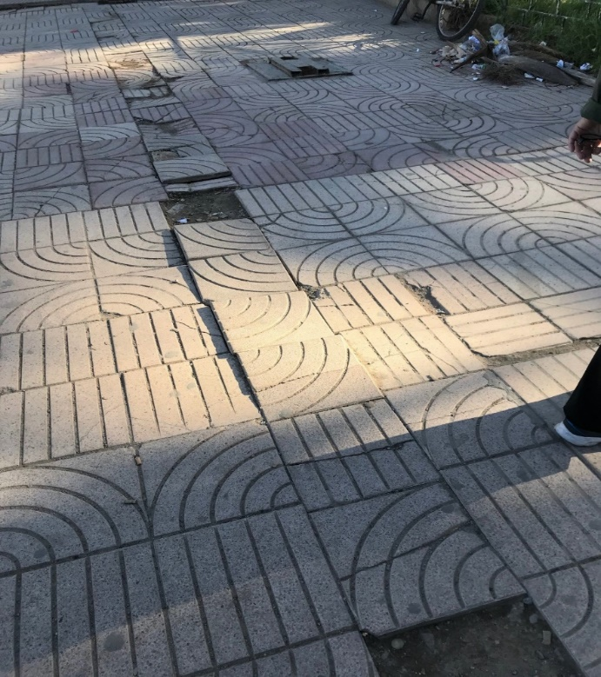
What is wrong with these pictures?
Notes:
What’s wrong with these pictures? Picture on left – person only has 1 foot and turned sideways on ladder. Hi potential for ladder to tip and for employee to fall. Picture on right – Slip/trip/fall issue. A number of paver tiles are missing and/or buckling causing a trip/fall hazard.
Periodic inspections to identify and evaluate workplace hazards shall be performed by competent personnel, identified by the employer.
Prior to introducing new products or chemicals review the SDS for hazard information.

Slide 10
Accident Investigation
Procedures to investigate occupational injuries and illnesses
Steps to secure the scene
Identifying an investigation team
Steps for interviewing witnesses
Taking photos
Notes:
These procedures can be general in nature in the IIPP, but should be expanded upon in the Accident/Incident Investigation program

Slide 11
Correcting a Hazard
Methods and procedures for the correction of identified unsafe or unhealthy workplace conditions
Who should employees notify and how?
Documentation of the correction.
Notes:
Once an inspection has identified a hazard or unsafe condition, managers and supervisors should correct it and the correction, or corrections should be documented. Documentation of corrections can include pictures, receipts, and so on, and should be kept along with inspection records. Furthermore, corrections should also be made when an unsafe or hazardous work condition is observed. If a hazard cannot be immediately fixed without endangering employees and property, managers and supervisors should remove all exposed personnel from the area, except those employees who are necessary to correct the issue. Employees who are correcting the issues should be provided with necessary safeguards to assure their safety while performing their work.
Even though the statements may be kept general in the IIPP, these methods and procedures should be expanded upon in company policies and accident reports.

Slide 12
Training
When training and instruction will be provided to employees, including training for managers and supervisors.
Employers are required to provide training to its employees at the following times:
Upon hire or new job assignments
When new substances, processes, procedures or equipment are introduced to the workplace
Whenever an employee is made aware of a new previously recognized hazard
Notes:
In addition to inspections, employees are required to be trained on procedures and hazards that are present in the work environment. Training should be provided at the following times: • When the IIPP is first put into place: • To all new employees; • When employees are assigned to new jobs where they have yet to receive training,; • When new substances, processes, and procedures or equipment are introduced that represent a new hazard; and When managers and supervisors are made aware of a new or previously unrecognized hazard. Also, supervisors should attend trainings on safety and health hazards to which employees under their immediate direction and control may be exposed to, such as chemicals, processes, and so on. Finally, employees need to be trained on the procedures for accessing the IIPP program should they choose to review it.
Best practices are to document all provided training via sign in sheets or other digital means

Slide 13
What training is required
Injury Illness Prevention Program (IIPP)
Hazard Communication (HAZCOM)
Bloodborne Pathogen (BBP)
Fire Safety
Notes:
There are other areas of safety that may be more specific for the area you work in and would be covered as a job specific type training

Slide 14
Recordkeeping
For Supervisors
Supervisor’s Report of Accident/Injury
Inspection Forms
Training
Accident Investigations
Employees
Remember you need to sign-in when receiving training
Notes:
These documents must be maintained for at least 3 years.
EMPLOYEES RIGHT TO ACCESS THE IIPP Cal/OSHA requires that employees have access to the IIPP and other safety programs if they wish to view them. Access can be provided in one of two ways: • A printed copy that is provided within 5 business days of receiving a request from an employee or a designated representative. A designated representative must have a written authorization from the employee they are representing which contains the name and signature of employee authorizing the designated representative to access the Program on behalf of the employee, the date of request, the name of the designated representative (either an individual or organization), and the date upon which the request expires if it is less than 1 year. An electronic copy of the program may be provided if the employee or designated representative has agreed to receive an electronic copy; or • Allowing employees unobstructed access to the program through a company server or website. The server or website should allow the accessing employee to review, print, and email the current version of the Program. Unobstructed means that the employee, as part of his or her work duties, uses electronic means of communications with managers or coworkers. If your company has purchased programs from GotSafety, then all programs may be found on both the website and mobile application. The mobile application is free for both IOS and Android devices and can be found on the Google Play or Apple App store for download.

Slide 15
Appendices
Appendix A
General Safety Rules
Appendix B
Safety Action Plan
Appendix C
Notes:
Appendix A: Safety rules per Cal OSHA or more strict than cal OSHA on activities that employees regularly conduct
Chemical use, machine guarding, fall protection, etc.
Appendix B:
Purpose: Manage and provide accountability for follow-up of all safety-related corrective actions.
Include any action related to the Safety Program. Including why you are taking the action will help when prioritizing.
Example Action Items include those which pertain to safety committee tasks, incident investigation follow-up action items, hazard identification findings, employee safety suggestions, behavioral-based safety observations, incident trend analysis, safety training development, reviews of written safety policy and program documentation.
A three-tier priority system is recommended – High, Medium, Low or 1, 2, 3. Limiting the number of High priority items keeps your organization focused on next steps. Reprioritize as action items are completed or added.
Appendix C:
Conduct a hazard assessment to discover which safety programs your facility needs. The following is a list of commonly required programs and should be converted into a list of your existing safety programs.
Examples: BBP, Confined Space, Fall protection, Hazcom…

Slide 16
Questions?
Notes:
In summary, remember that the Injury and Illness Prevention Program is the master program for all other required programs. This written program must have all required components and have all aspects of the requirements completed for it to be considered effective. Employees have the right to access this and other programs if they choose to review the material and managers and supervisors should become familiar with their company’s particular IIPP program.

